Slide 1
CKD – Chronic Kidney Disease Algomarker
Medial EarlySign
DM to CKD
HTN to CKD

Slide 2
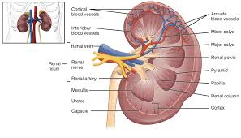
Clinical Background – Kidney Physiology
Kidney Function
Filter the blood to produce urine which contains water and waste products.
The kidneys also make hormones/enzymes that help with:
– Blood production
– Blood pressure regulation and hydration
– Bone and mineral balance
Notes:
Filter the blood to produce urine
make hormones/enzymes that help with:
Blood production and such

Slide 3
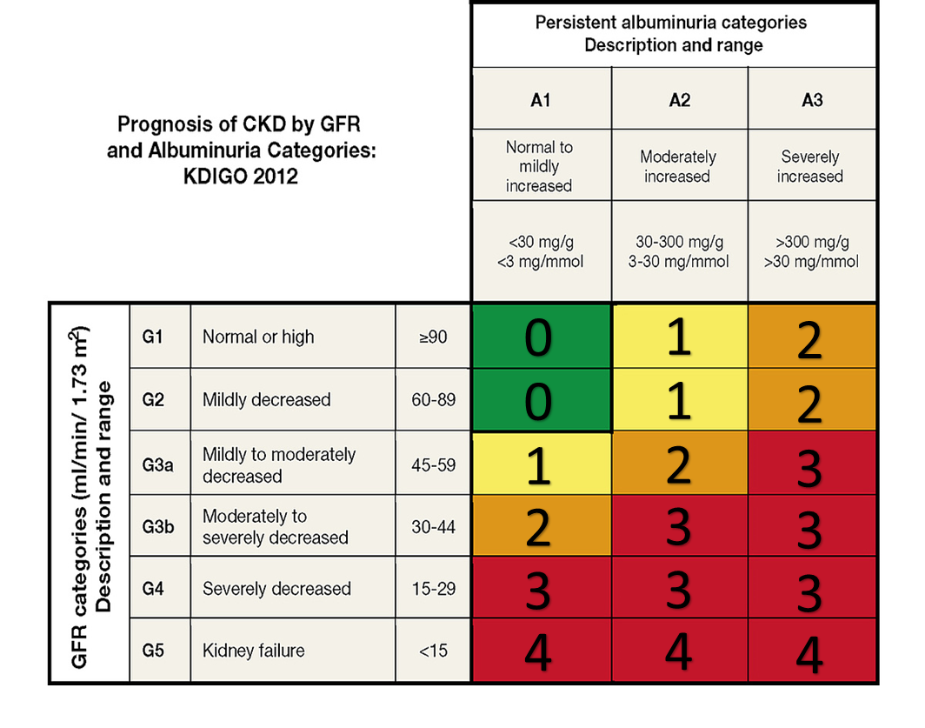
Clinical Background – Kidney Injury/Damage
Acute Kidney Injury (AKI): rapid loss of kidney function – usually reversible
Chronic Kidney Disease (CKD): permanent kidney damage
defined as 2 successive measurements indicating kidney damage at least 3 months apart (vs AKI)
Measured by:
eGFR (% of kidney function remaining)
urine albumin (protein) (measure of kidney damage)
Urine MicroAlbumin
Urine Albumin Over Creatinine
Urine Albumin
Urine dipstick for protein
Urine Total Protein
Urinalysis Protein
Urine Protein Creatinine
US: 44 million adults have CKD (2014) = 14.8%*; 11.8% (2006)
Associated with 2.2 million deaths (mainly CV disease)(2013)
960K deaths from ESRD
Nearly half a million US patients are on dialysis
eGFR: Creatinine, Age, Gender
*National Institute of Diabetes and Digestive and Kidney Diseases (NIDDK)
Notes:
Some background on kidney damage: AKI is rapid loss of kidney function usually caused by dehydration / trauma.
usually reversable.
CKD is permanent kidney damage,
defined as 2 successive measurements indicating kidney damage at least 3 months apart.
The relevant measurements are estimated glomerular filtration rate and urine protein
This categorization is a bit more fine grained than what you were working on in the workshop yesterday
Stats:
44 million adults have CKD in the US
Associated with 2.2 million deaths (mainly cardiovascular)
Nearly a million deaths from end stage renal disease
0.5 a million patients on dialysis in the US

Slide 4
CKD Algomarker
Goal: Identify patients (ages 40-80) from the high-risk population that are at risk for CKD stage shift from stage 0 to stage 2-4 within 3 years.
High-risk patient: a history of hypertension / diabetes or are prediabetic.
Action: personalized disease management including follow-ups intervals and drugs control.
Details: Cohort was divided into 3 groups : CV – 70% , Validation – 20% , Validation 10%
Train population for each model was matched by years.
2 experiments (1/1/2010 -1/1/2013) , (1/1/2013-1/1/2016)
Patient can be control in one experiment then case in another.
Results were compared to alternative models : Age , eGFR (last Value) , Simple Logistic model.
Product: The same model, applied to hypertensive patients in one case and to diabetic patients in another.
Notes:
Goal: Identify patients that are at a high risk of progressing to CKD stage 2-4 within 3 years out of the currently healthy patients with a history of hypertension or diabetes.
To make the most out of the available data we ran 2, 3 year experiments matching the training population by years – which is a standard capability of out code.

Slide 5
Population Statistics and incidence
Experiment (1/1/2010 – 1/1/2013):
Start
patient ages (40-80) 3,001,716
Censor
unknown state before 52,210
no state data before 1,117,148
unknown state after 49,122
no state data after 538,957
no creatinine in the last 3 years. 210,862
state (1-4) before 102,146
Not in risk groups (HT, DM, preDM) 251,992
Both experiments:
Group | patients | % | CKD (2-4) | Incidence
All groups | 1,368,277 | 100% | 7,824 | 0.57%
Hypertension | 1,178,557 | 86% | 7,257 | 0.62%
Prediabetes | 533,290 | 39% | 2,066 | 0.39%
Diabetes | 237,777 | 17% | 3,460 | 1.46%
Cohort
patients in all groups (HT, DM, preDM) 679,279
patients with HT 591,864 (87%)
patients with preDM 252,678 (37%)
patients with DM 115,386 (17%)
Notes:
Some statistics to give you an overall impression of what the cohort looks like..
The UK THIN data was used to train this mode.
After censoring out the irrelevant patients we are left with the experiment cohort at the bottom.
There is of course an intersection of patients with HT and DM
While HT is a lot more prevalent than DM, the incidence rate of CKD among diabetic patients is higher.

Slide 6
Cohort - shift from stage 0 to 2-4 in 3 years
The cohort simulates the way the product will be used
Start experiment
date
End experiment
date
2010-01-01
2013-01-01
At start experiment date :
Age 40 – 80
High risk patients (HT, DM, preDM)
Patients with state 1-4 are censored.
Patients with unknown state are censored.
Patient with state 0 or AKI are included.
At end experiment date :
Patient with state 2-4 are treated as cases.
Patient with AKI or state 0-1 are treated as control.
Patients with unknown state are censored.
In order to differentiate between CKD and AKI in our data we defined a chronic state as one that occurred on at least two successive occasions more than 90 days apart
We predict Chronic kidney disease and treat AKI as controls.
אלדן
Notes:
Our cohort simulates the way the product will be used, with the aim being to avoid bias as much as possible.
We define an experiment start date and filter the patients according to the parameters we set:
Ages 40 – 80
With a background of HT or DM – here we use the infrastructure’s capability to calculate registries on demand, giving us a pretty good assessment of which patients are inflicted with the background conditions at any time, even though the base read codes available may not be complete.
We filter out patients that are already at an advance stage of ckd, again, this calculation is integrated into the code so it can be of use in future projects.
We filter out patient for which we do not have enough data to decide their CKD state
At the end of the experiment we also filter out patients for whom the state is unknown.

Slide 7
Patient examples
pid: 5003851
AKI
Cumulative state
???
Point stage
0
0
0
0
0
0
0
0
2
0
0
0
2010
2012
2014
2016
Experiment I
Experiment II
State 0 - control
At this point we can’t tell if this is AKI or CKD – censor from experiment II
pid: 5000339
Cumulative state
???
Point stage
0
0
0
0
0
1
1
1
1
1
1
2012
2014
2016
Experiment II
state 1 - control
pid: 5003917
Cumulative state
???
???
1
2
1
1
2
2
2
0
2
2
1
Point stage
1
0
2
2012
2014
2016
Experiment II
state 2 - case
Notes:
One of the more involved parts of the experiment setup is deciding on reasonable guideline for determining the patient’s CKD state. Some of the considerations are:
Not peeking ahead into the future to make any decision.
Censoring out the least amount of patients – to conserve as much useful data as we can but also to limit biases that this type of censoring could introduce to the data.
Here you can see some examples of what the data looks like.

Slide 8
Model Signals
Demographic (+)
Age, gender, smoking history
Labs:
Creatinine, eGFR, urine albumin, urine albumin over creatinine, urine creatinine, urea, urine total protein
Cholesterol, LDL, HDL, triglycerides
Hemoglobin, hematocrit, WBC , albumin
Glucose, HbA1C
Blood pressure
Comorbidities:
Diabetes
Hypertension
Drugs:
Blood glucose lowering drugs
Diuretics
Antithrombotic agents
Lipid modifying agents
Agents acting on the renin-angiotensin system
Minimal data required for score calculation
Most Contributing Features
Notes:
We used the XGBoost algorithm to train the model.
The signals the final model uses can be seen here.
The most important one’s are in red.
We can tell which are the most important signals using feature importance code.
As you can see – the features that were determined to be contributing the most make a lot of sense as they are the base signals that determine a patient’s CKD state as well as indications to whether they are diabetic and as we saw in the previous slide – the incidence of CKD among the diabetic population is very high.

Slide 9
Hypertension progression to CKD stages 2-4 within 3 years
Model validation results
Cohort: 40–80-year-old hypertensive individuals with normal kidney function
Blood Pressure: 2x [age >60 and systolic >150 mmHg] or [age <60 and systolic >140 mmHg] or [diastolic >90 mmHg]
Hypertension diagnostic codes or Drugs
eGFR ≥ 60 mL/min/1.73m2
Microalbumin < 30 mg/g
Positivity Rate (%) | 1.0 | 3.0 | 5.0 | 10.0
Sensitivity (%) | 18.2 | 34.2 | 44.5 | 60.0
PPV (%) | 13.3 | 8.3 | 6.5 | 4.4
AUC | 0.856
By flagging the top 3% of a hypertensive population at risk, our Hypertension CKD AlgoMarker™ captured 34.2% of patients with hypertension likely to progress to CKD within 3 years First retrospective validation study performed on a UK population
Notes:
Here you can see the final results of our hypertension CKD algomarker

Slide 10
Diabetic progression to CKD stages 2-4 within 3 years
Model validation results
Cohort: 40–80-year-old diabetic patients with normal kidney function
Glucose: 2x >125 mg/dl, or 1x ≥ 200 mg/dl
HbA1C: 1x ≥ 6.5%
Diabetes diagnostic codes
Diabetes drugs prescribed
eGFR ≥ 60 mL/min/1.73m2
Microalbumin < 30 mg/g
At least one of
Positivity Rate (%) | 1.0 | 3.0 | 5.0 | 10.0
Sensitivity (%) | 12.3 | 25.5 | 34.6 | 48.7
PPV (%) | 22.3 | 15.4 | 12.6 | 8.8
AUC | 0.813
By flagging the top 3% of a diabetic population at risk, our Diabetic CKD AlgoMarker™ captures 25.5% of diabetic patients likely to progress to CKD within 3 years First retrospective validation study performed on a UK population
Notes:
You can see that the algomarker preforms slightly better on the hypertensive population, this makes sense as that model can make more use of the diabetic related signals to discriminate between patients.

Slide 11
History analysis – Time since last eGFR
Analysis of time gap between prediction date and last eGFR value.
Filtering history before prediction date ensuring patients still has eGFR values
Prediction date
Before filter
After filter
pid: 5000339
pid: 5000339
Filter
eGFR
eGFR
eGFR
eGFR
eGFR
eGFR
eGFR
eGFR
 | Sens@FPR 5% HT population
Filter time | After filter | CI | Before filter | CI | Gap (%)
<=0.5 year | 43.5 | [42.0-45.0] | 45.3 | [44.3-46.8] | 4%
<=1 year | 40.5 | [38.8-41.9] | 44.7 | [43.5-46.9] | 10%
<=2 years | 37.2 | [35.7-39.5] | 44.2 | [42.8-45.8] | 16%
2006
2008
2010
2006
2008
2010
pid: 5000350
Experiment start
pid: 5000350
Experiment start
No eGFR
eGFR
eGFR
eGFR
eGFR
eGFR
eGFR
2006
2008
2010
2006
2008
2010
Experiment start
Experiment start
pid: 5001239
pid: 5001239
It seems important to have eGFR data in the last year.
eGFR
eGFR
eGFR
eGFR
2006
2008
2010
2006
2008
2010
Experiment start
Experiment start
Notes:
These is an example of one of the more interesting analysis that we run.
To check how important it is to have a recent eGFR value for the model performance. Because the timing of the eGFR result is bound to be correlated to other covariates that may influence the model performance, we ran a more intricate analysis – filtering out relevant populations and deleting their history to see how well the model would preform on them.
This history filtering capability is implemented in our infrastructure, making this sort of analysis simpler to run.

